Slide 1

L4/5 Group 1
Alice Baker
Dragos Liche
Kenneth Pirkle
Jordan Carman

Slide 2
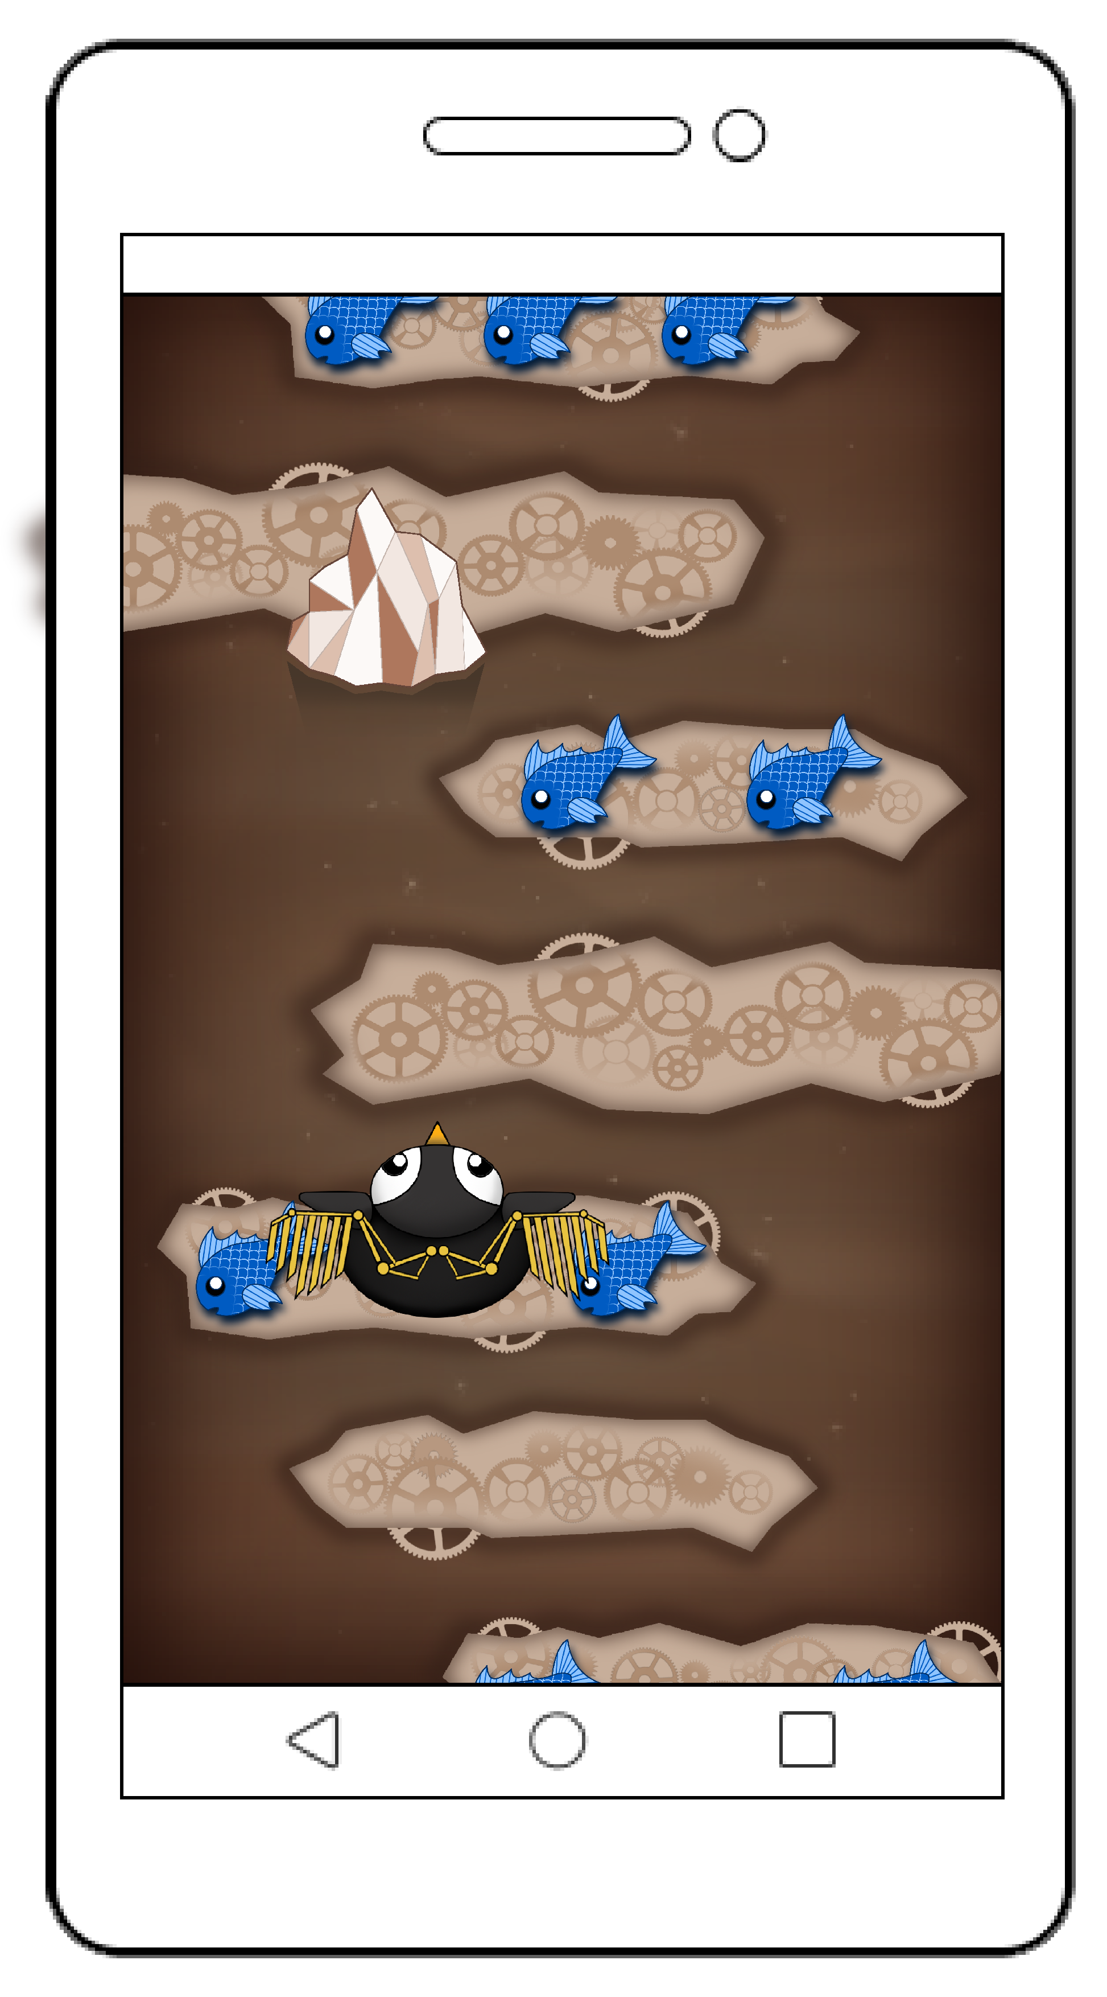
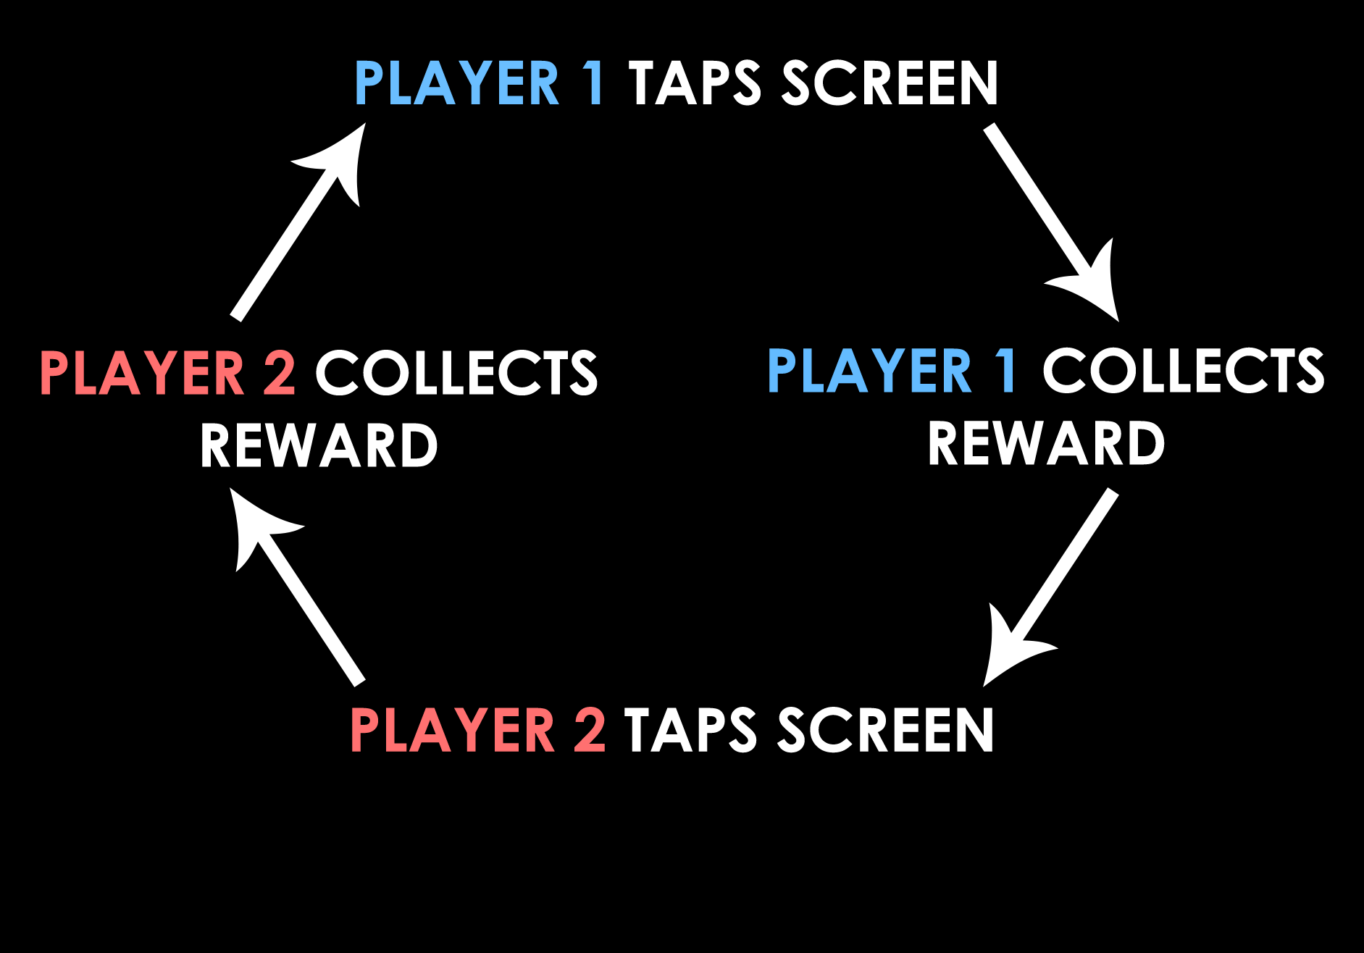
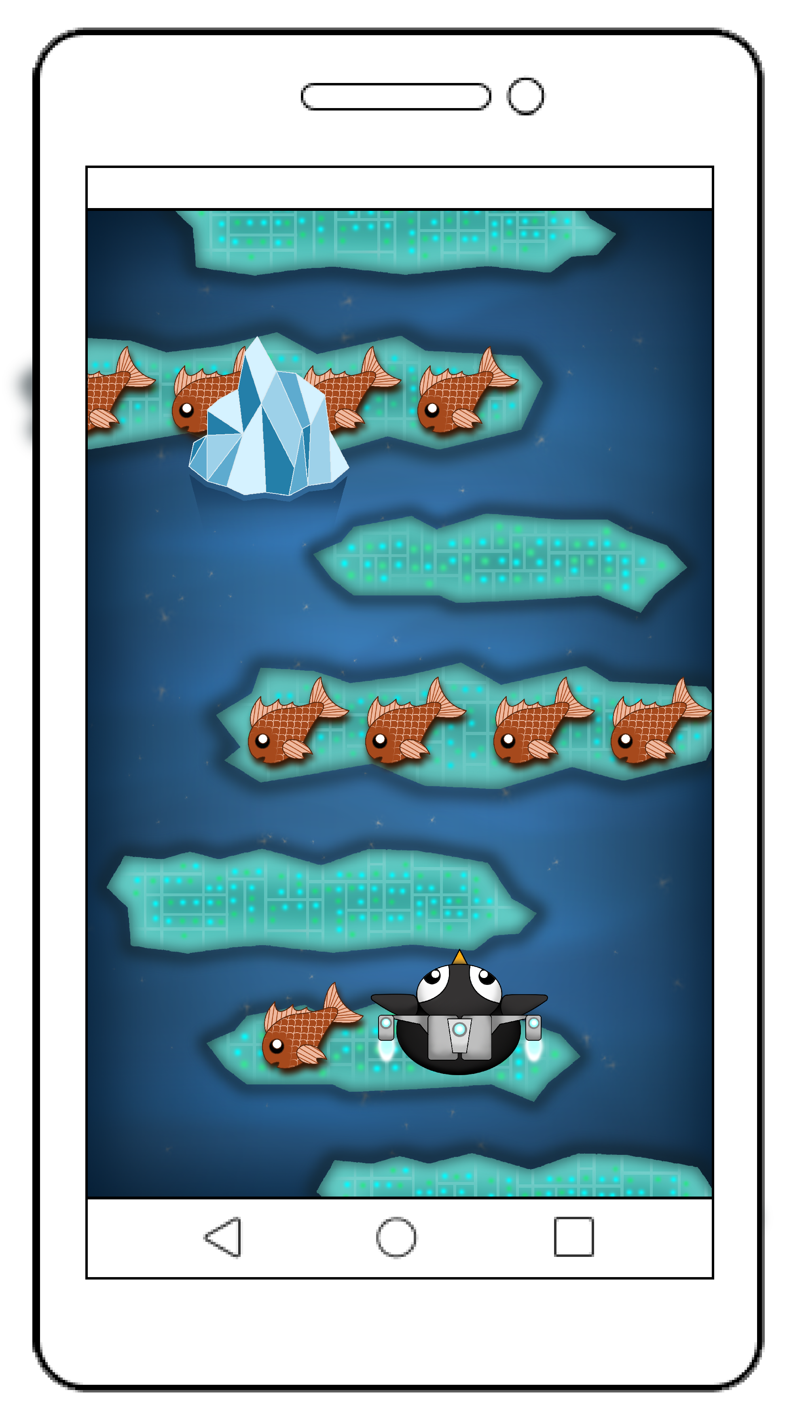
Core game loop
Notes:
Alice

Slide 3
The game
Player 1 theme
Player 2 theme
Collect points and power-ups
Game lasts 2 minutes, best of three rounds
Lose points if character misses platform
Contrasting theme for each player
Notes:
Jordan
Still taking in turns to move character onto moving platforms
Points are higher value closer to the edges
Choice of power ups to sabotage or protect

Slide 4
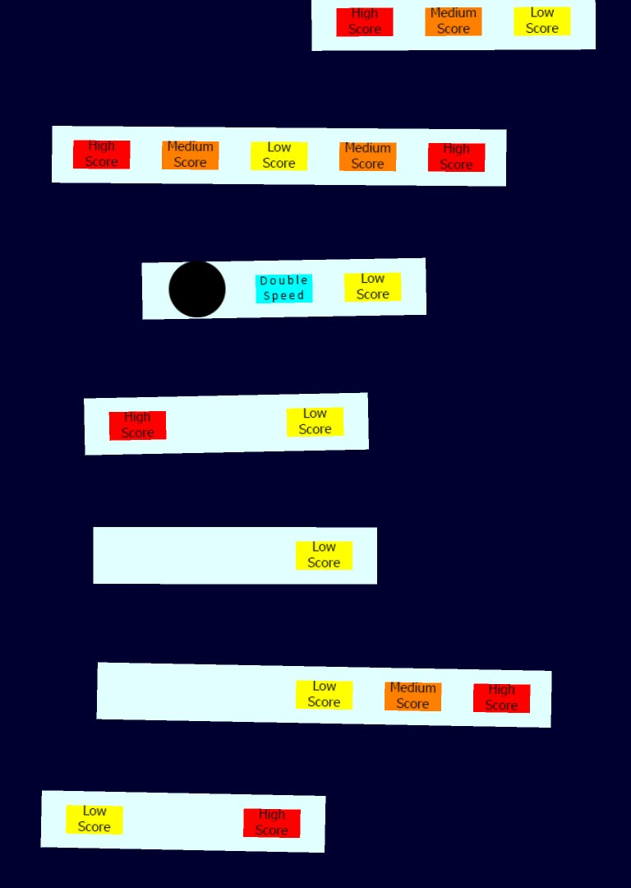
Playtesting
Previously...
Players didn’t know how to play
Around 2 minutes of gameplay
Liked the power-up, would like to see more
Camera was too slow
Notes:
Ken and Jordan

Slide 5




Playtesting iteration
Contrasting artwork
Scoring and rounds
More power-ups
Progression
Notes:
Ken and Jordan

Slide 6
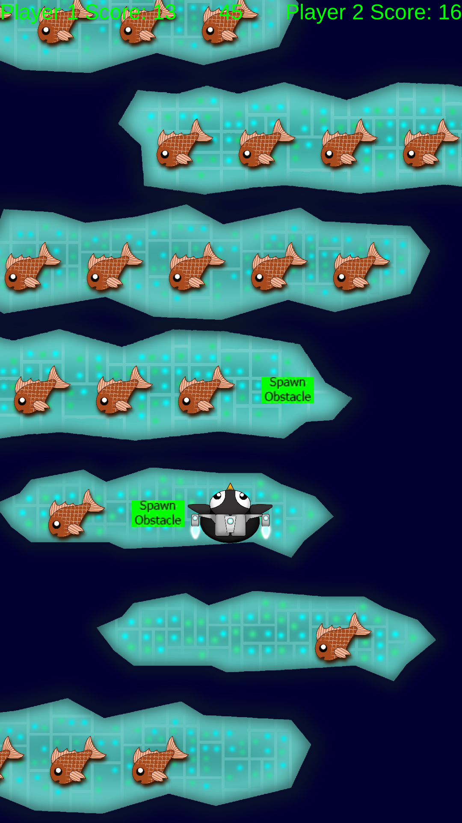
Playtesting
Players didn’t know how to play
Liked all the power-ups
Liked gameplay time
Obstacles and power-ups were random
Notes:
Ken and Jordan

Slide 7
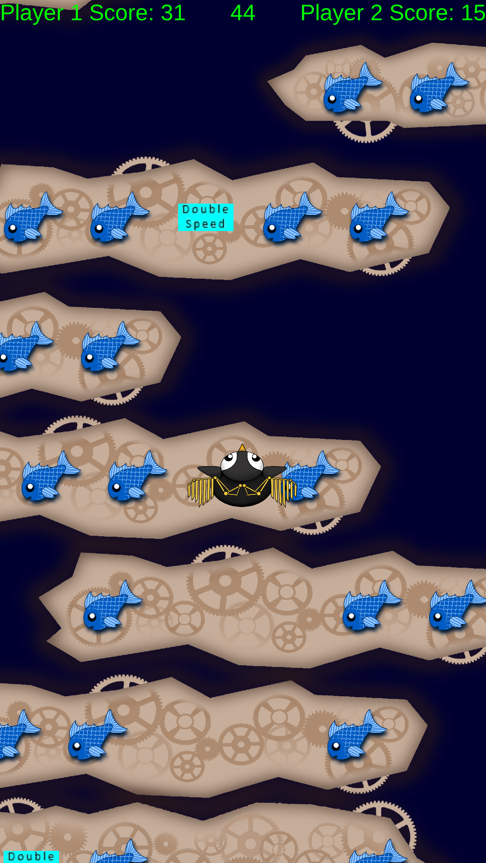
Playtesting
EMOTIONS –
Laughter
Amusement
Focus
Fiero
Notes:
Ken and Jordan

Slide 8

Future plans
Iterate artwork and animations
Instructions on how to play
Background music and sound effects
Bug fixing
Notes:
Ken and Jordan

Slide 9
Thanks for watching!
Any questions?
Notes:
Alice

